Slide 1
Digital Media Design
By Ivy Ye and Emmie Dong
Notes:
Emmie & ivy- (show game) For our physics project. this is what we made…
(switch to slides) We created it using Unity

Slide 2
Digital Media Design
computer science + arts
use software/coding along with knowledge of design elements to create art
skills include: programing, screenwriting, video production, animation, etc.
Notes:
Ivy- Digital media desingers- motion graphics, screenwriting, digital audio production, video production…
Unlike animation majors that focus on using software and tools in the creation of art, our graduates help to build and extend those tools and employ them to create new graphics techniques and applications

Slide 3
UPenn’s DMD Program
Dr. Norman Badler
Programs Taught
Java, Python, C++
Autodesk Maya, Unreal Engine 4, Houdini
Career Directions
Movie effects, production, games, graphic design, social media companies
Working at Pixar, Disney, Google, Facebook, etc.
Notes:
Emmie- We interviewed Dr. Norman Badler, the Rachleff Professor of Computer and Information Science at UPenn… about UPenn’s DMD Program. The program is based in the computer science department, so its mostly software- and technology-oriented, but also combines it with art. It requires students to understand how code works rather than just using it.
Since its’ so focused on computer science, while other artists are limited to the tools at hand, the program teaches students to program their own, so they can do more with what they know.
We used unity instead of maya or unreal, because we couldnt find anything else that exceeded our budget of 0 cents.
Ivy- Current projects include facial animation, reconstructing historical environments for VR interfaces, and simulating 3D materials.
This summer, one of the research projects theyre carrying out is to create a simulation of human activities in an archaeological or historical setting. They will create the program using Maya, Unity 3D and Unreal, and will focus a lot on the programming side of it. The simulation will replicate individual and group behaviors in a community.
so our students go in all sorts of career directions, including movie effects, production, games, graphic design, social media companies,
Many graduates of the DMD program have worked in major animation studios like PIxar and Disney. Other paths include working with interface design for companies like Google and Facebook and working in game design studios. One of their new professors has actually worked with disney on the software for simulations in Moana of water, sand, lava, and cloth

Slide 4
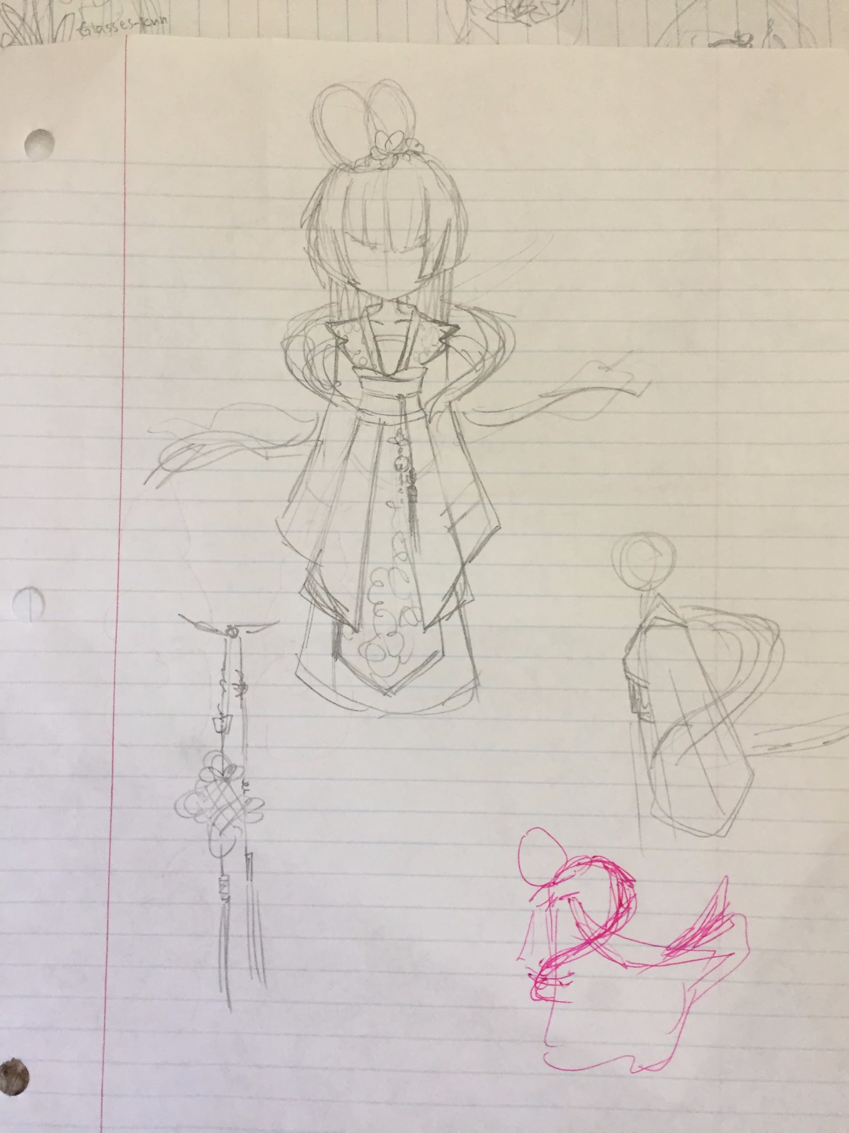
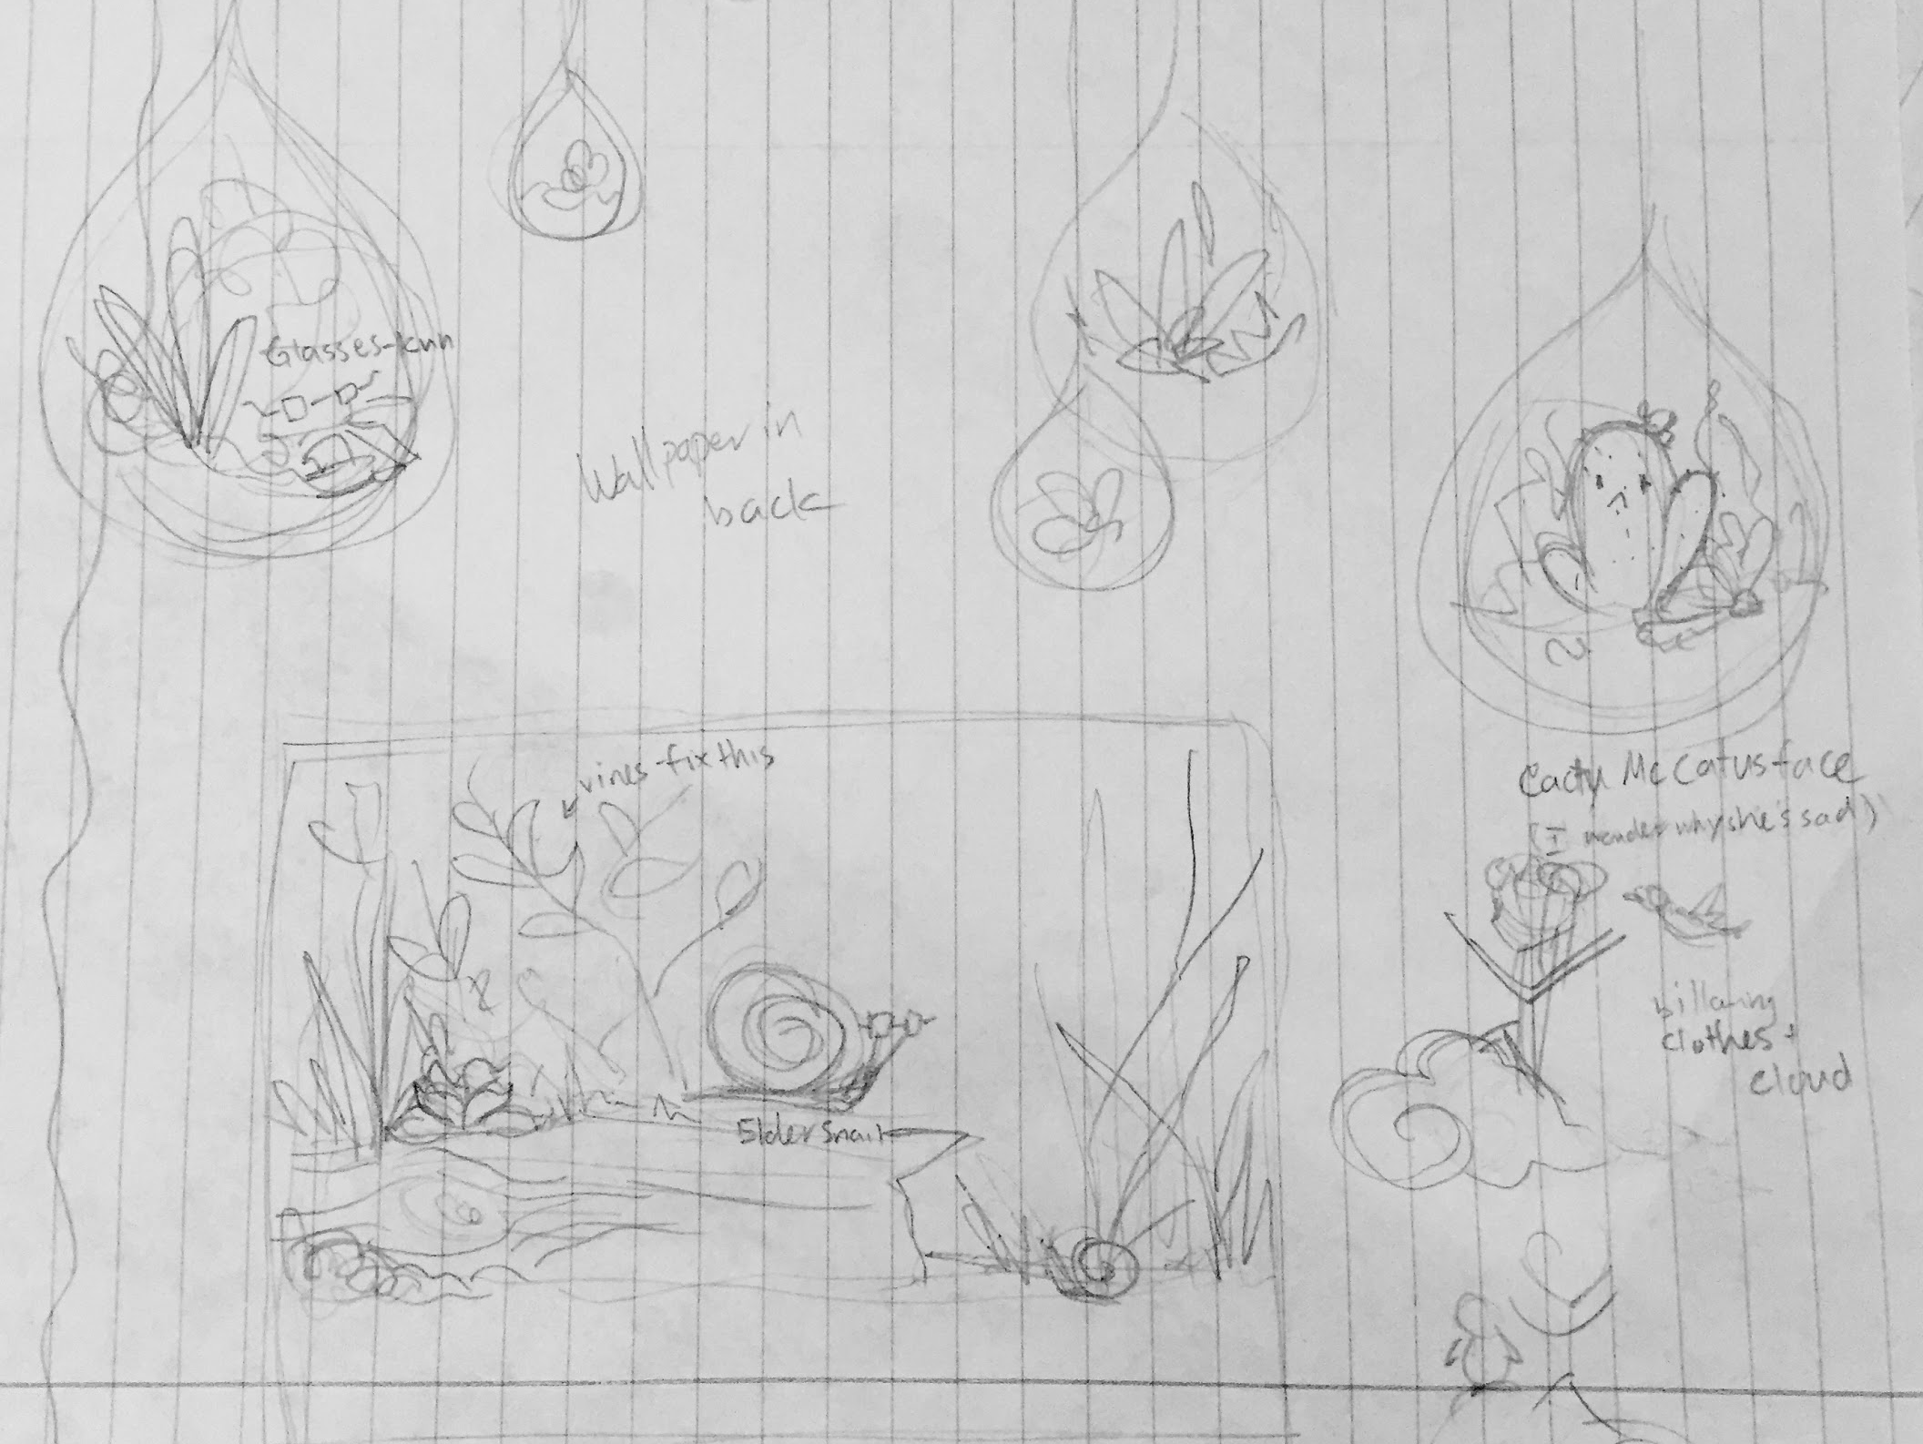
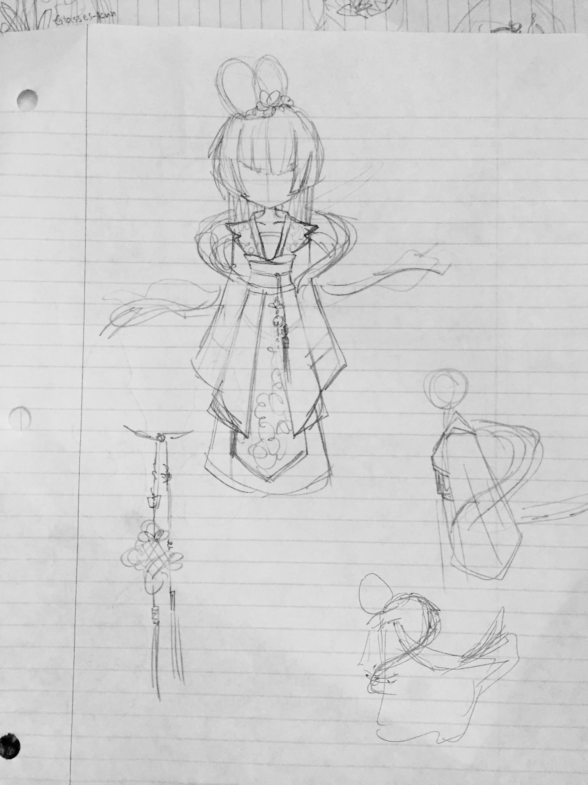
Planning Our Project
Notes:
Ivy- Here’s original designs…. We were a bit too ambitious.. :`>... left- the player… right- is the scene for the game..

Slide 5
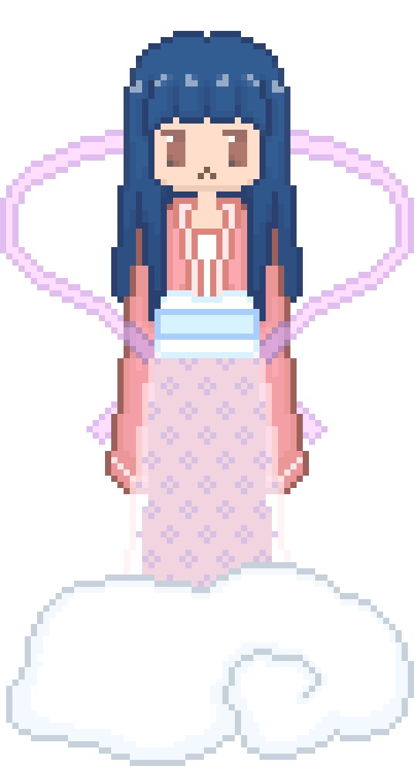
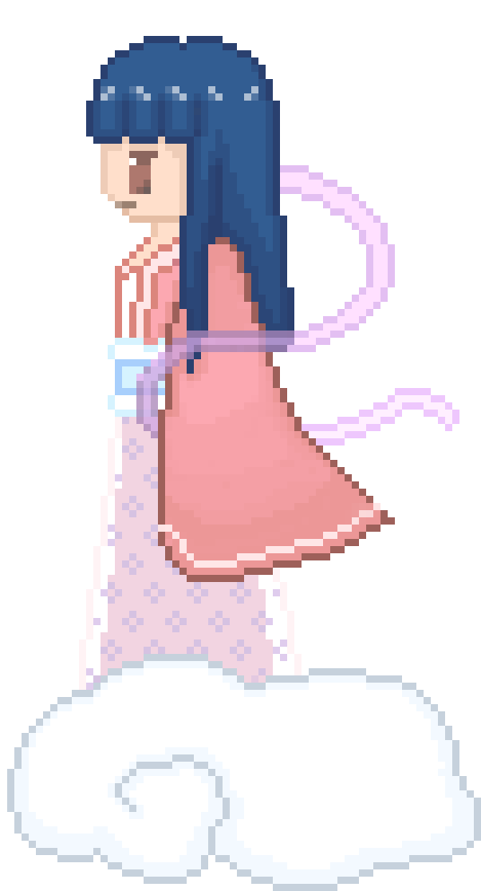
Final Player Design
Notes:
Ivy- We (emmie) realized that we sucked and didnt have the skills to make pixel art that complicated… so.. This is our Simplified and final design of our player..

Slide 6
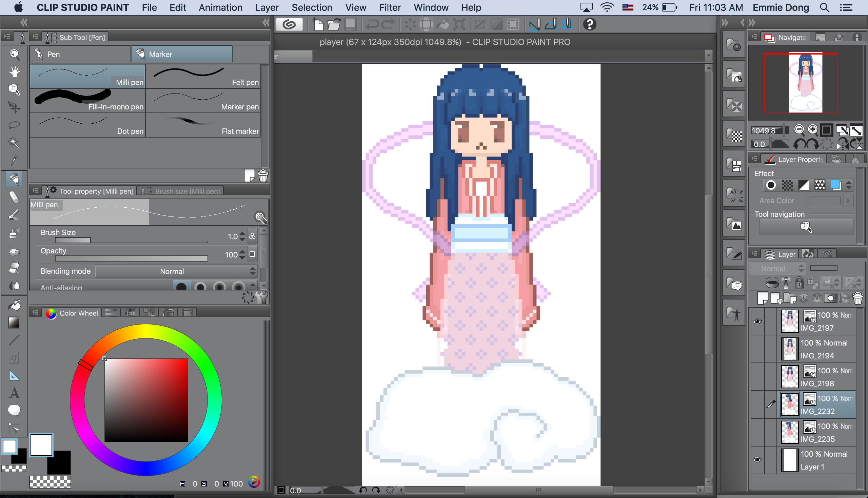

Slide 7
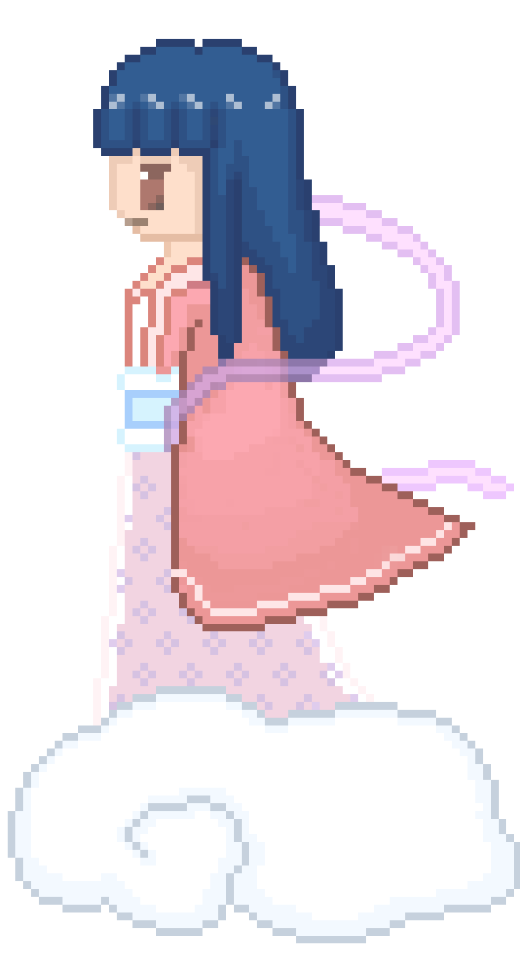

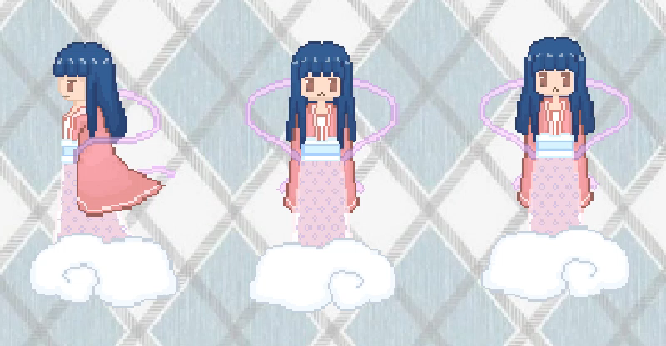
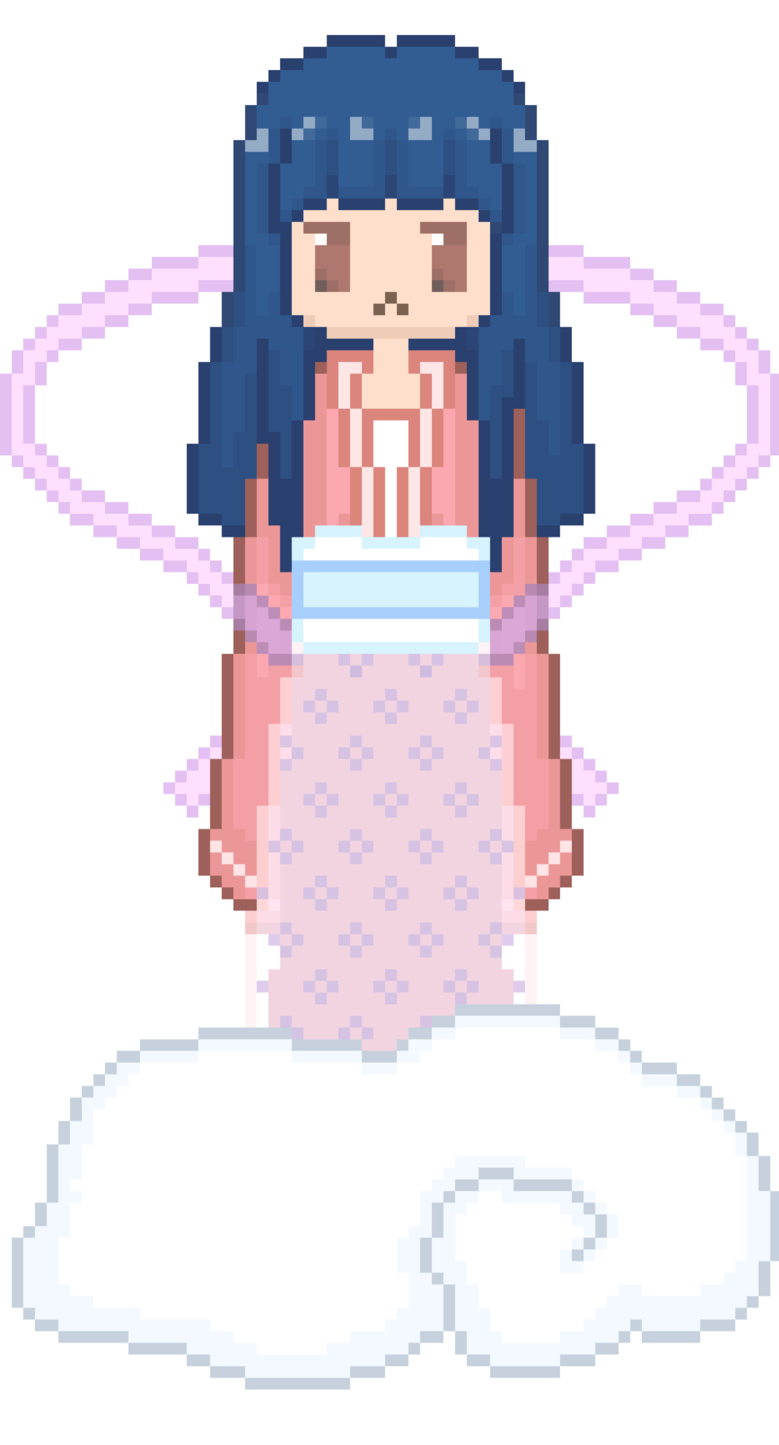
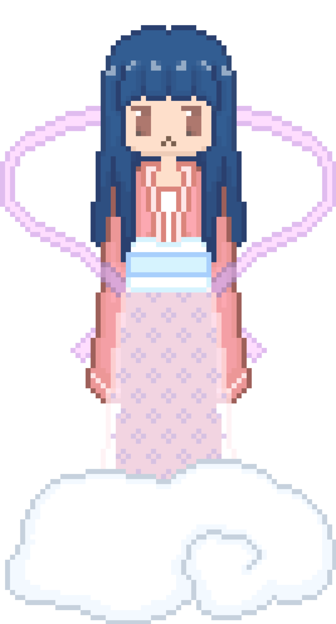
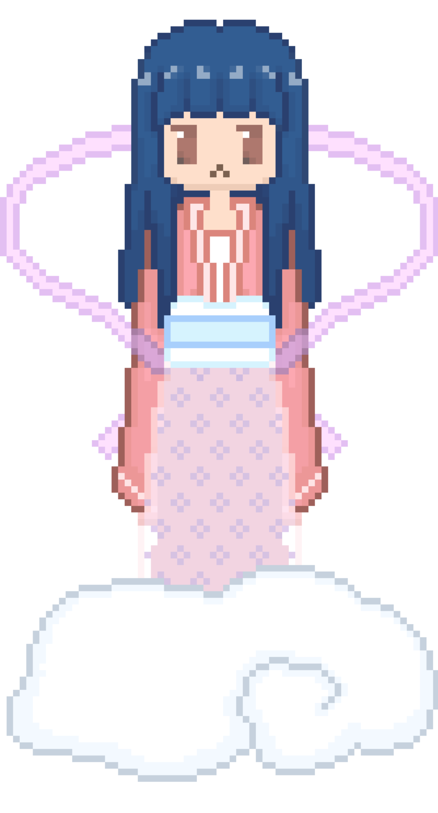
The Animation
Notes:
Ivy we shifted some of the pixels up to create a second image. By looping the two, we could mimic a floating motion.
It looks kind of weird when standing still :/ but its all good when moving.

Slide 8
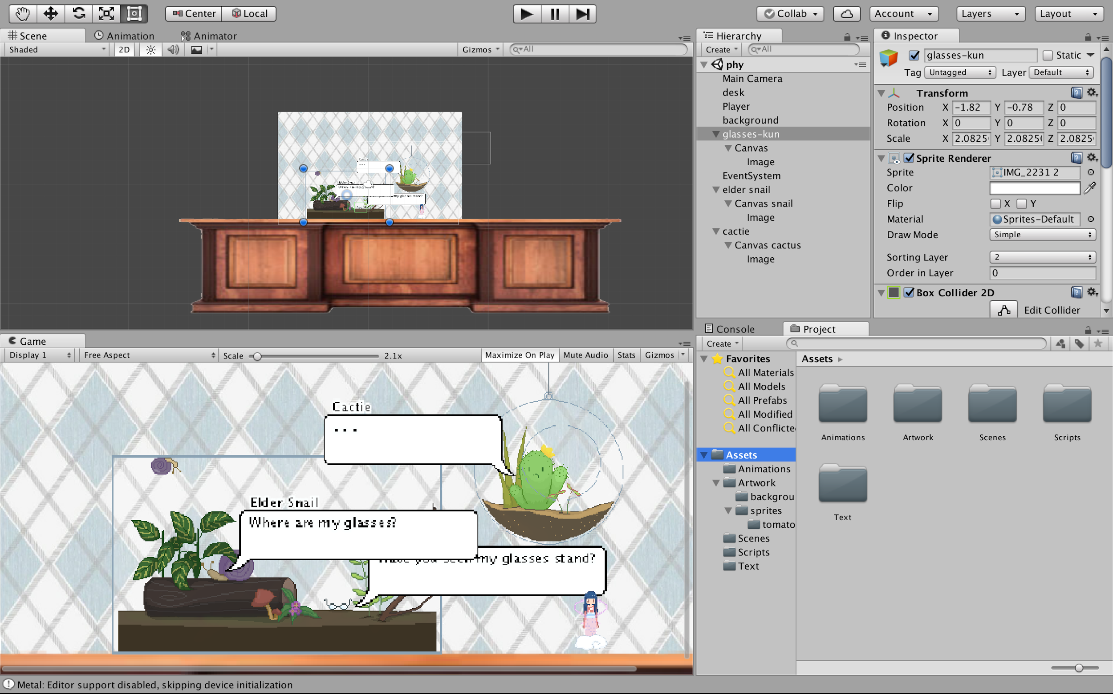
Unity
Notes:
emmie

Slide 9
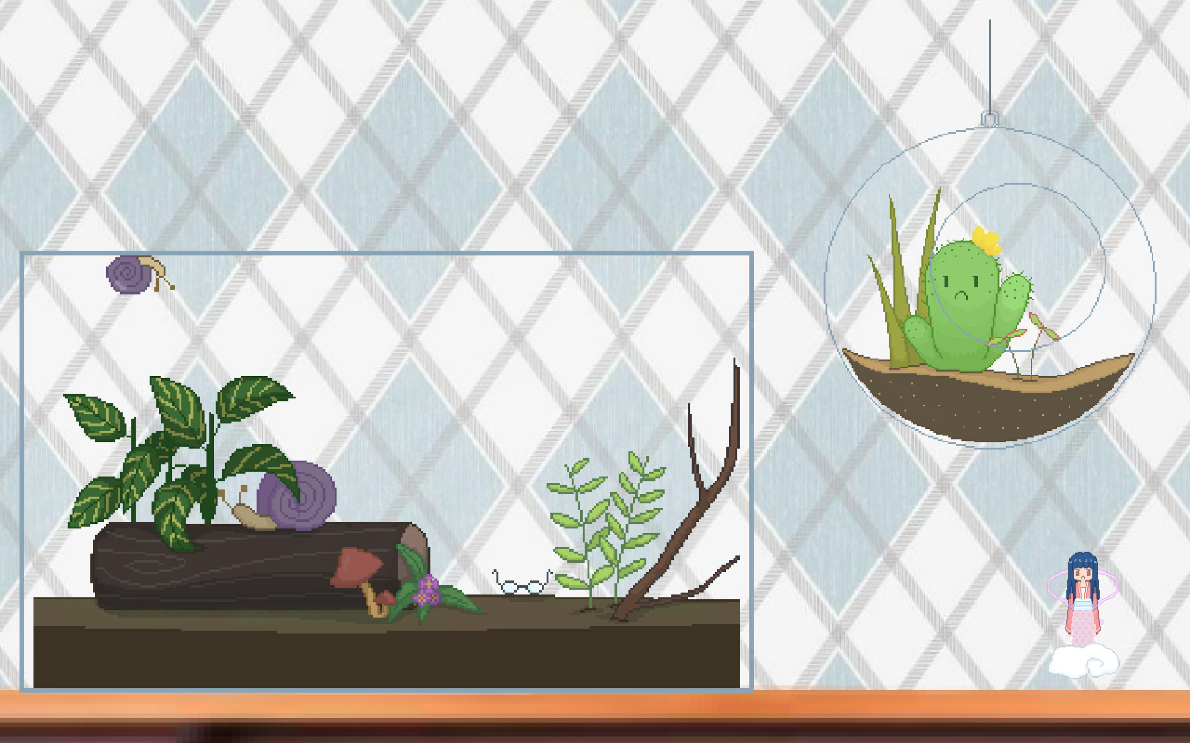
Notes:
emmie

Slide 10
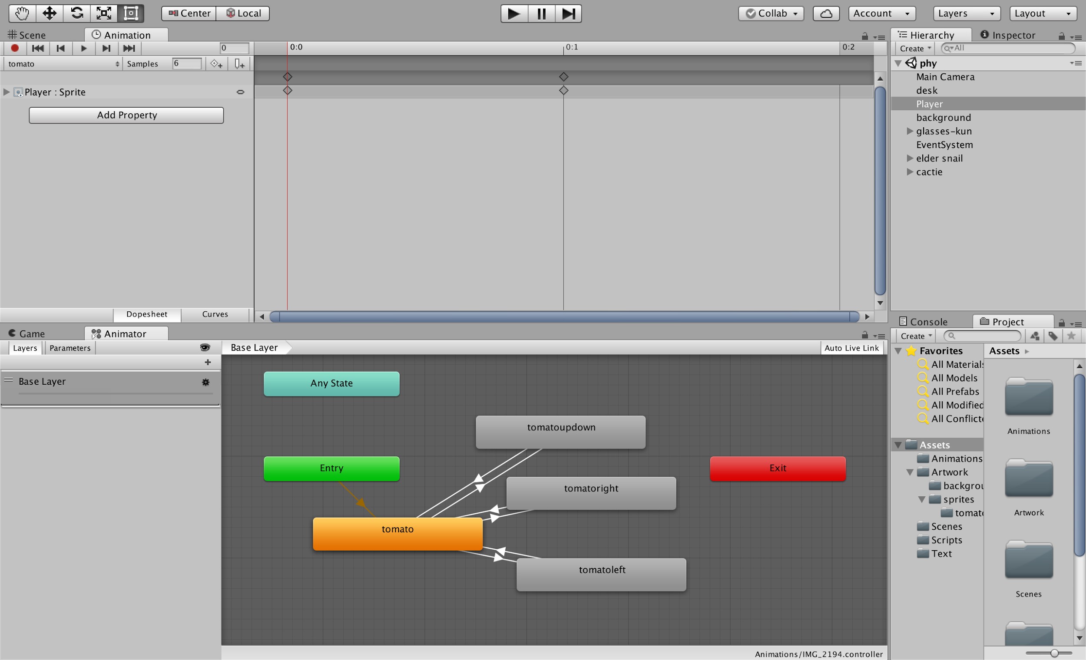
Unity Animation
Notes:
Emmie- in the animation panel, on top, it shows the frames of the animation.. You can drag the images into here to create an animation
you can also connect different animations together… We have 4 different animations… standing still, moving right, left, vertically..
In the bottom, you create transitions between the different animations, which need to be coded. We’ll cover them later..

Slide 11
Coding in Unity
Uses C# and javascript
YouTube and lynda.com
Unity’s help forums
Notes:
Ivy- Unity uses C# and Javascript for coding.. We used C#.. It was unrealistic to learn a new coding language in the time we were given AND create a project from it… so we used Youtube and lynda.com tutorials as well as unity’s help forums to search up specifics and find code that could work. We used our knowledge of Java as a guideline to navigate the code.

Slide 12
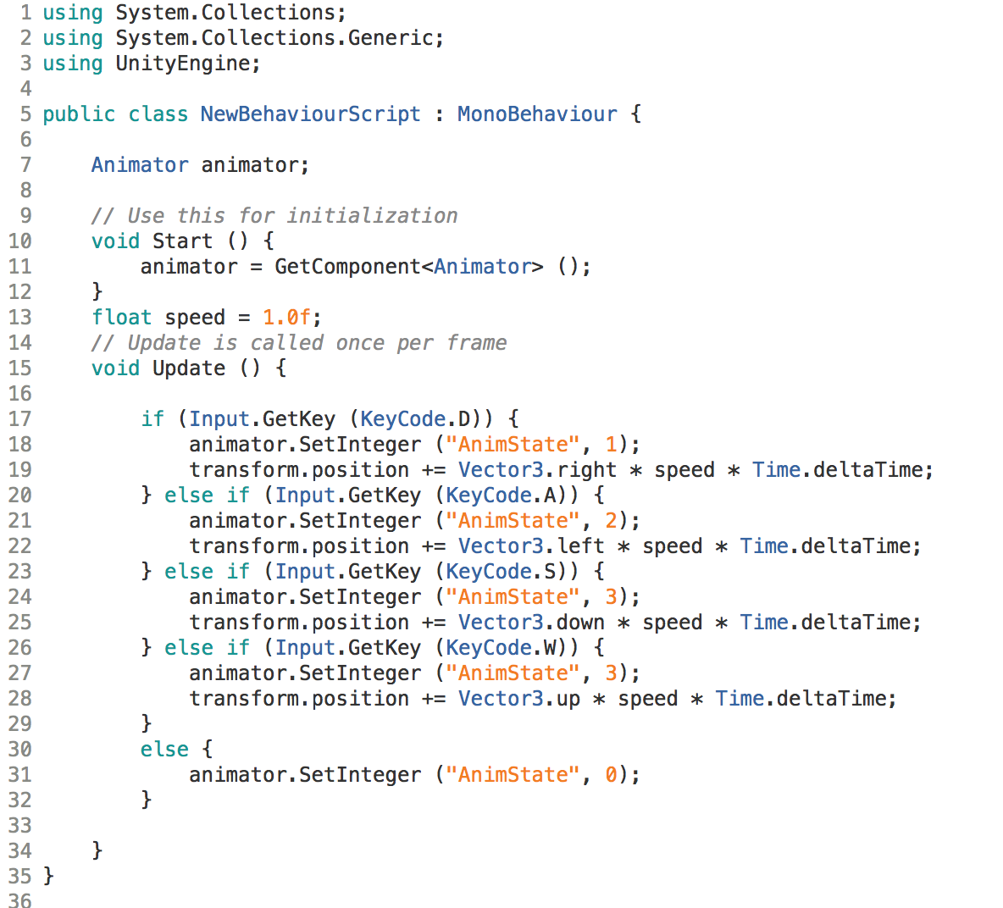
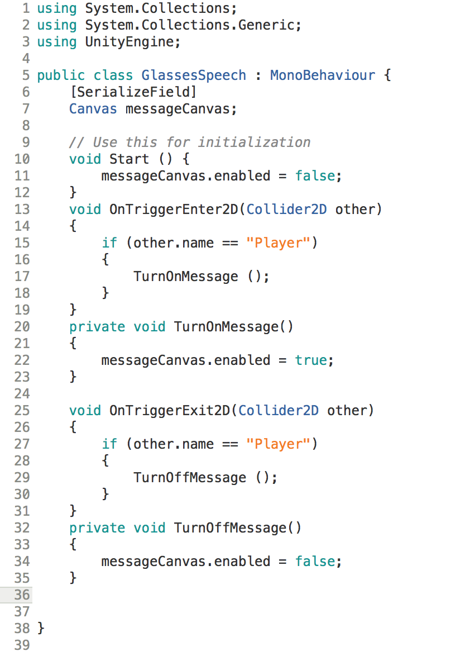
Notes:
Ivy- These are the two scripts that we used.
On the left is the code for the transitions between different animations from earlier.
float speed= 1.0f;
that sets how fast we want the player to move…..
void Update()
D A S W are the controller keys…
when you press a key, the program goes through these if, else if statements to see if the key matches one of them..
Ex: (you press S.. it checks if its D… no so then checks if its A.. no.. then checks if its S.. yes) And if it does match, it carries out the functions in the brackets...
animator.SetInteger (“AnimState”, number) triggers one of transitions between the animations (each were given a value, 0, 1, 2, 3… 0 is the transition to resting state, 1 is the transition to moving right, 2 is the transition to moving left, 3 is the transition to moving up or down).
The one line under that, transform.position… moves the sprite around in the x y directions
On the right is the code we used for the speech bubbles

Slide 13
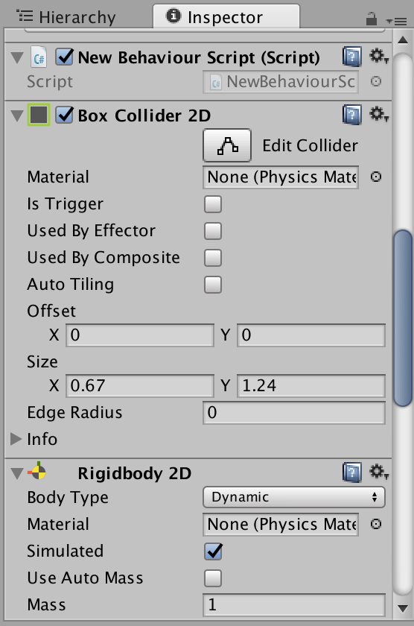
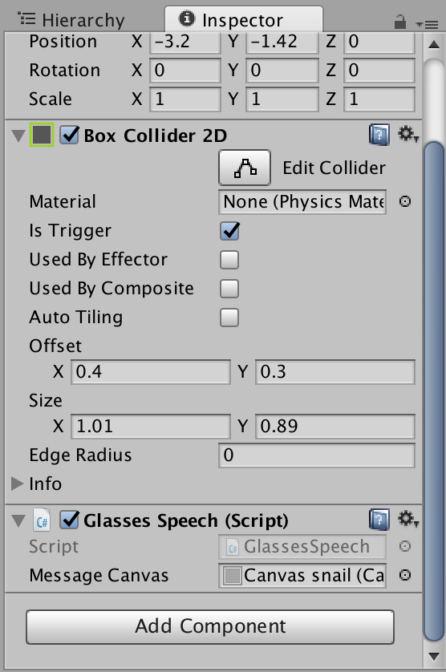
Notes:
Emmie-
The right- again, this is the code we used for the speech bubbles
The middle…
I added the script to the snail here… Yea I named the code glassesSpeech even though this is for the snail. But after i did the code for the glasses, i realized i could use the same script for all 3 npcs..
I also added a box collider.. The check mark by “is trigger” sets it as a trigger for something to happen, in our case, causes a speech bubble to pop up..
In the code, OnTriggerEnter2D it makes it so that if the player touches a box around the npc (that box is set by this size thing.. demonstrate) it activates the speech bubble by using TurnOnMessage()..
OntriggerExit2D deactivates the speech bubble when the player leaves
The left
This is for the player, which also has a box collider, except it doesnt act as a trigger. But you could activate it and make the player lose 1 health point when it touches the cactus… but we didn’t go that far so its not checked in our case
We also gave it a rigidbody2D component, which is to give the player a presence. You can add stuff like mass, friction, and gravity and stuff, so its not just an image.

Slide 14




Programs Used
Notes:
Ivy- Unity for the animation
Clip studio paint, pixelmator, and medibang paint for all the art

Slide 15
Thank You!

